Slide 1

International Trade
CS-620 Introduction to Data Science
(Fall -2021)
Presented By:
Sara Negri (01088613)
Swati Mishra (01212676)

Slide 2
Objective
Focusing on international trade data from 1999 to 2019 to see which country has consistently been the largest international trader.
Targeting Countries(United States, China, Canada, the United Kingdom, Mexico, and Japan, India, Italy)
Targeting Continent( Africa, Asia, Europe, America)

Slide 3
Data Sources
Dataset | Sources
International Trade | world.bank.org
Population Density | ourworldindata.org
Foreign Direct Investment | world.bank.org
Life Expectancy | world.bank.org
GDP Per Capita | ourworldindata.org
Technology | world.bank.org

Slide 4
Target Audience
Political Science & Foreign Affairs Students
International Business Students
Researchers
Global Users
Technical & Non-Tech Users

Slide 5
Tools & Technologies
Google Collab
GitHub
Python Programming Languages and Libraries
Excel

Slide 6
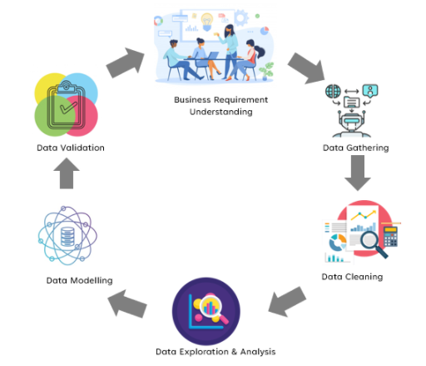
System Architecture

Slide 7
Main Goals & Purpose of Analysis
Performing cleaning of the large datasets and merging to analyses them.
Performing Data exploration with Country and Continent dataset
Analyzing the dataset of both Country and continent
Validating assumptions for Linear Regression
Perform different types of Regression.
Performed group clustering and computed value of K through Elbow Algorithm.

Slide 8
Data Cleaning
Important technique in model building that comes after you collect data.
Removing irrelevant data from the dataset.
Removing Years before 1999
Remove countries
Remove NAN parameters
Compute Balance of Trade

Slide 9
Merge Data
Process of combining two or more data sets into a single data set.
Necessary when we have raw data stored in multiple files, or data tables which needs to be analyzed in one go.
Merging Data for Countries
Merging Data for Continents

Slide 10
Data Exploration
Process of analyzing the data graphically.
Based on Country
Based on Continent

Slide 11
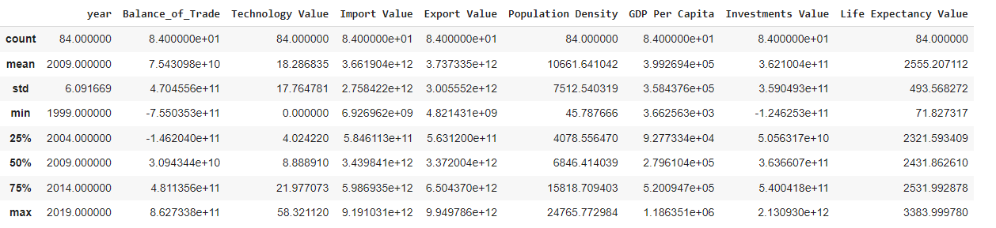
Descriptive Analysis

Slide 12
Based on Country

Slide 13
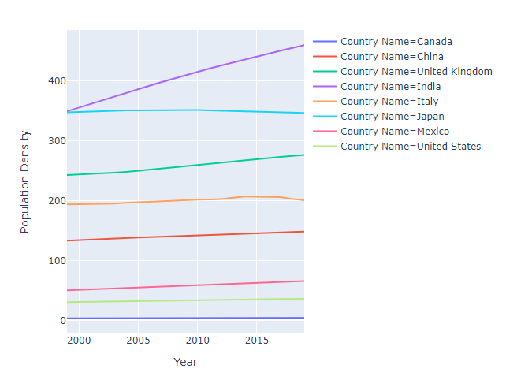
Population Density
Plot representing Population density among Years
India contains the population density

Slide 14
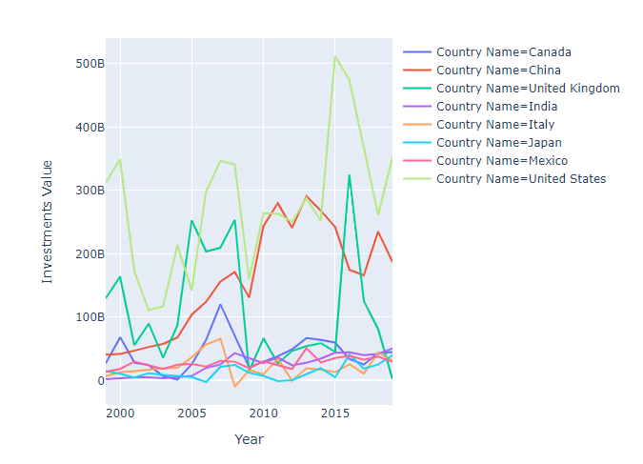
Foreign Direct Investment
Plot representing how change foreign direct investment among years by countries.
United States and United Kingdom have the same trend but different starting point.

Slide 15
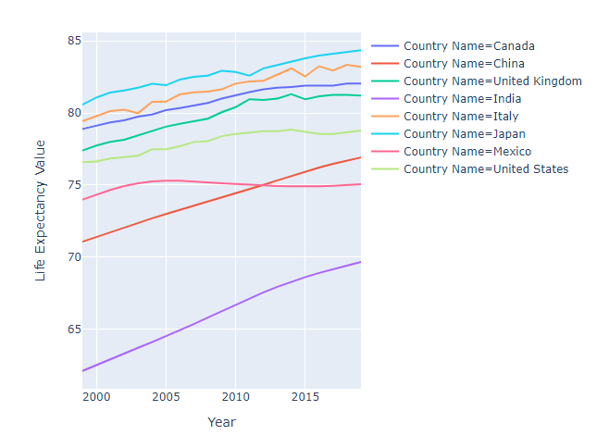
Life Expectancy
Plot represents how life expectancy value change among years by countries.
Japan has the highest life expectancy i.e., above 80 years old.
Indian has the lowest Life Expectancy score i.e., below 69.

Slide 16
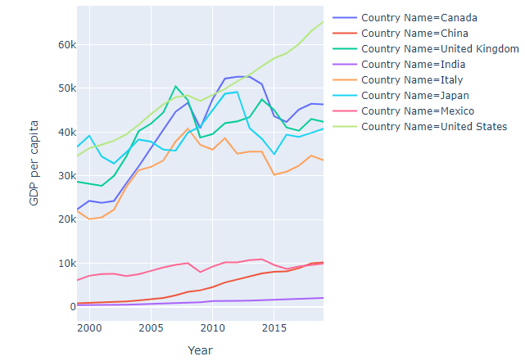
GDP Per Capita
Plot represents how GDP per capita change among years by countries.
United state has the highest GDP Per Capita excluding the year 1999, 2000,2007 & 2011.

Slide 17
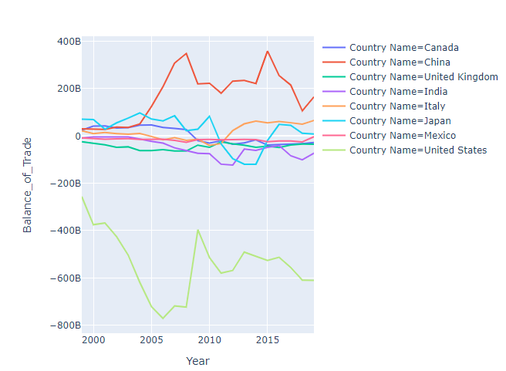
Balance of Trade
Plot represents how Balance of Trade change among years by countries.
All countries lying in range -122 to 97 exuding United states and China.

Slide 18
By Continent

Slide 19
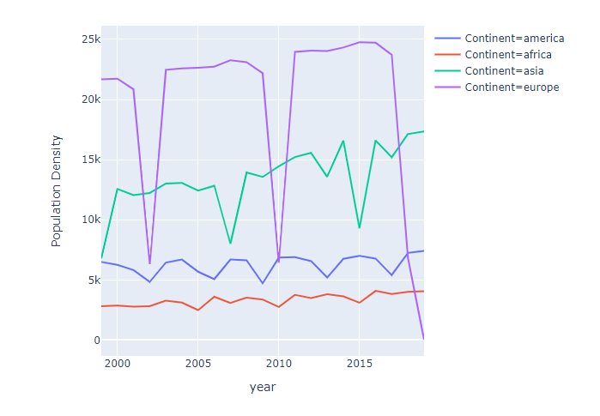
Population Density
Plot represents how Population Density change among years by continents.
Europe has the highest value form almost all years(1999 to 2001, 2003 to 2009, 2011 to 2017)

Slide 20
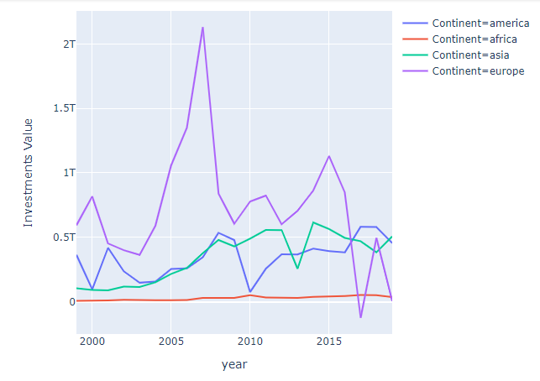
Foreign Direct Investment
Plot represents how Foreign Direct Investment change among years by continents.
Europe has the highest value except for 2016 to 2019.

Slide 21
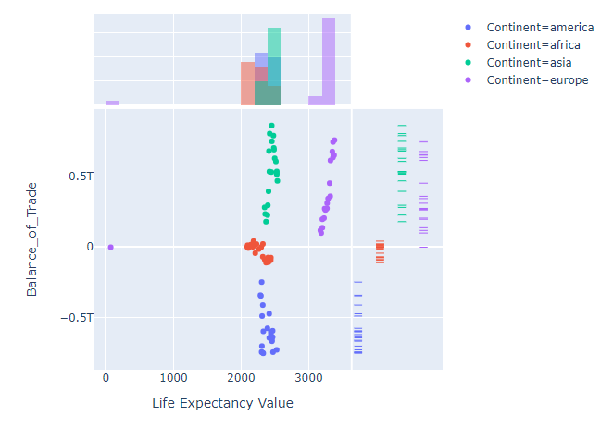
Life Expectancy
Plot represents relationship between Life Expectancy and Balance of Trade by continent.
Included distribution of both variables.

Slide 22
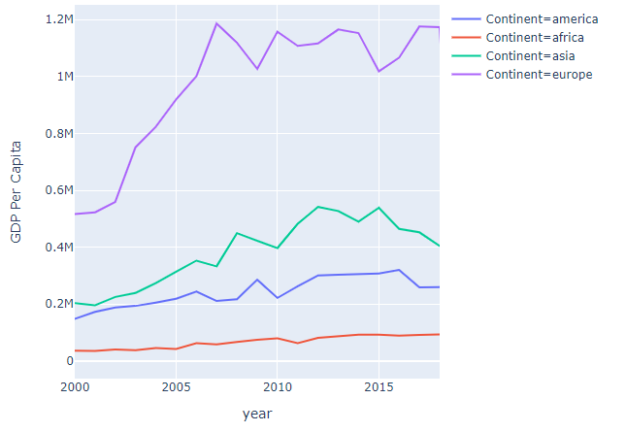
GDP Per Capita
Plot represents how GDP Per Capita changes among years by continents.
Europe has the highest total GDP per capita for all years.

Slide 23
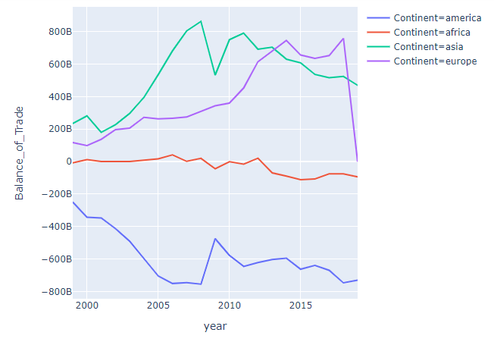
Balance Of Trade
Plot represents how Balance Of Trade changes among years by continents.
Asia has the highest Balance of Trade until 2013, after the graph's trends toward Europe as the highest value in trade.

Slide 24
Data Analysis
Process of analyzing & modelling data with the goal of discovering useful information, informing conclusions, and supporting decision-making.
By Countries
By Continent

Slide 25
By Country
Test for Linear Regression Assumptions
Linearity
Absence of Multicollinearity
Correlation among Residuals
Homoscedasticity
Multiple Regression
Testing Hypothesis

Slide 26
Linearity
A linear relationship between the dependent variable and the independent variables.
Computing relationship between the dependent variable (Balance of Trade) and the independent variables (all the other variables).

Slide 27
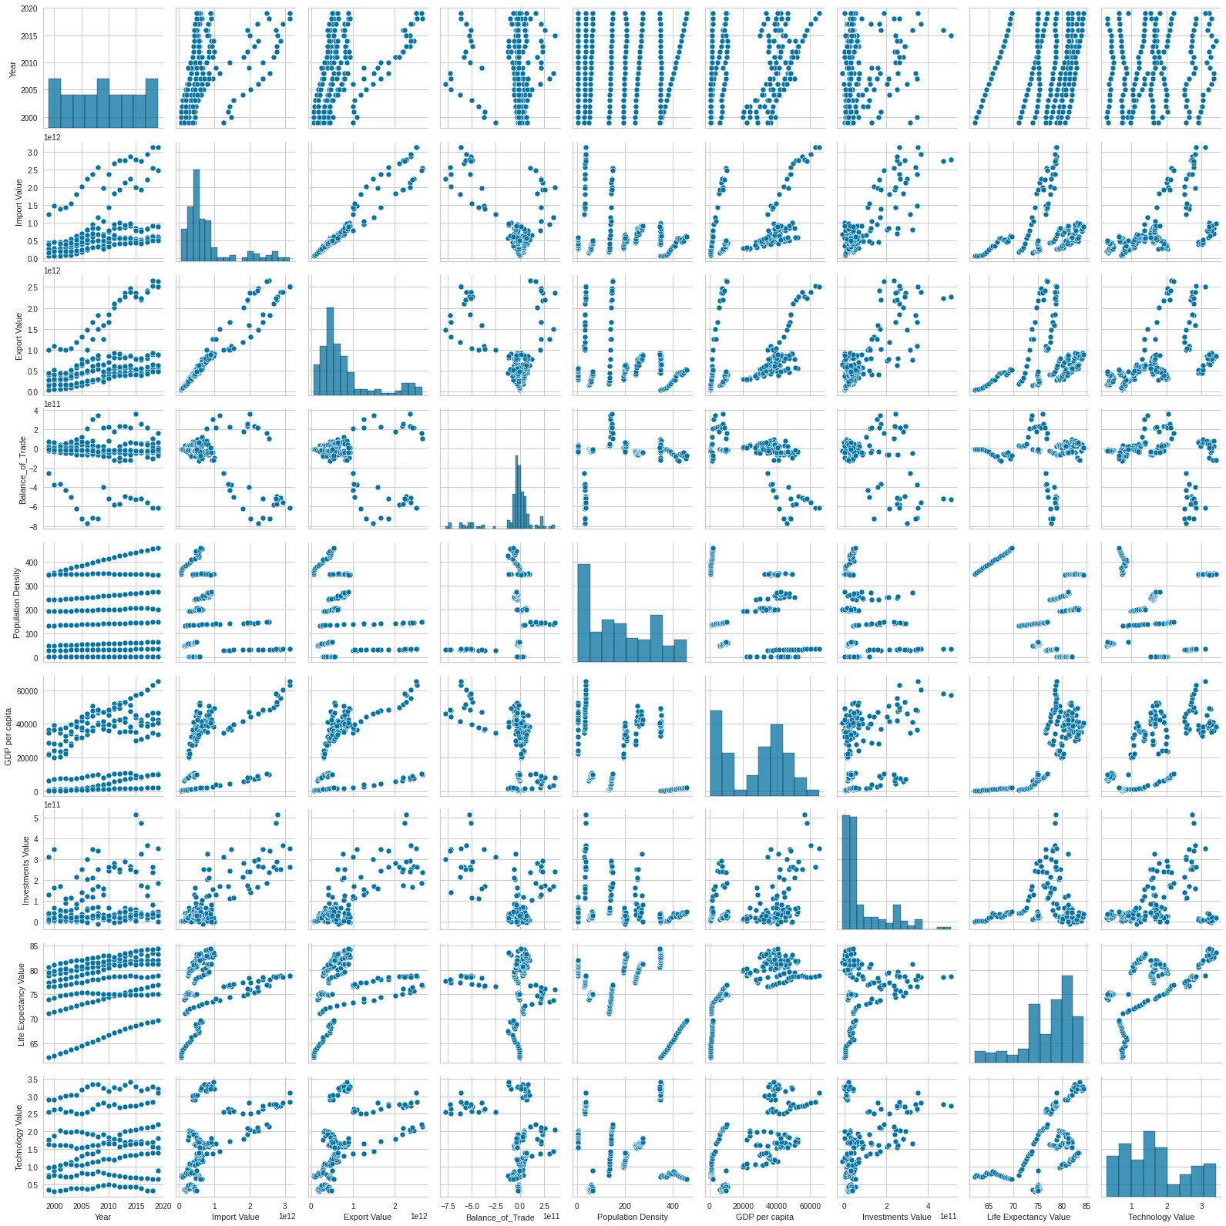
Linear relationships are shown between each two variables even if they are not perfect .

Slide 28
Multicollinearity
The multicollinearity is the presence of a high correlation between variables
In order to run the linear regression, we need that the independent variables are independent among them. In this way, we will be able to run the linear regression and estimate the model.

Slide 29
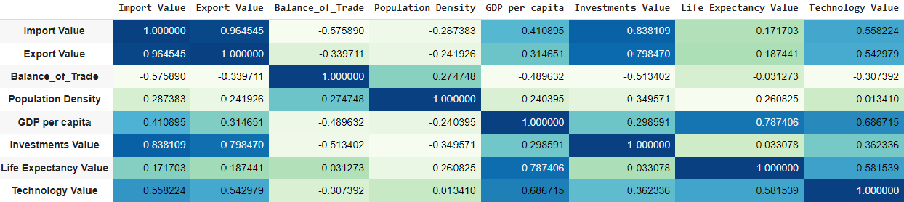
Absence of multiple collinearity results in no strong correlation among the independent variable .
Life Expectancy any GDP per capita have the highest correlation.

Slide 30

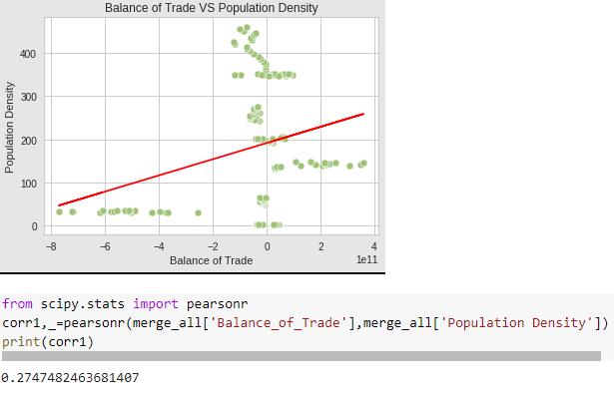
Balance of Trade VS Population Density
Correlation between Balance of Trade and Population Density.
Direction of relationship is not clear.
The Pearson's coefficient is equal to 0.2718, this means that the Balance of Trade and population density have a positive relationship that it is not so strong.

Slide 31
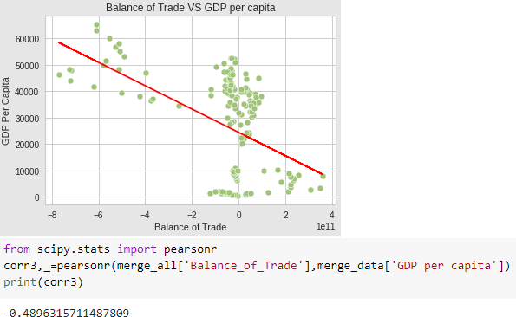
Balance of Trade VS GDP
Correlation between Balance of Trade and GDP.
The relationship between Balance of Trade and Real GDP per capita is enough strong and it is negative

Slide 32
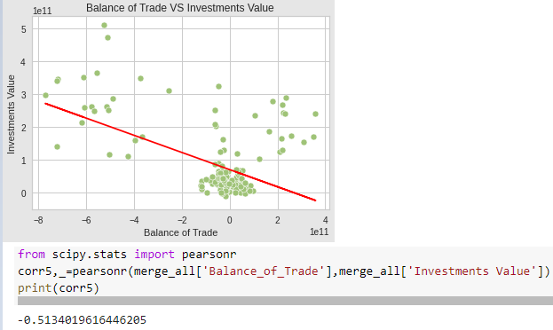
Balance of Trade VS Foreign Direct Investment
Correlation between Balance of Trade and Foreign Direct Investment.
Linear relationship between Investments and the Balance of Trade have a negative direction, but there are a lot of outliers.
The Pearson's correlation give us an almost strong negative relationship between Balance of Trade and Foreign Direct Investment.

Slide 33
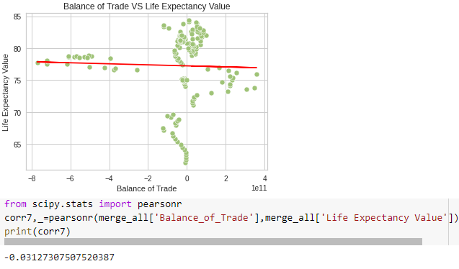
Balance of Trade VS Life Expectancy
Correlation between Balance of Trade and Life Expectancy.
The linear regression between Balance of Trade and Life Expectancy is not clear, so we need additional investigation.
The relationship between Balance of Trade and Life expectancy is not significant.

Slide 34
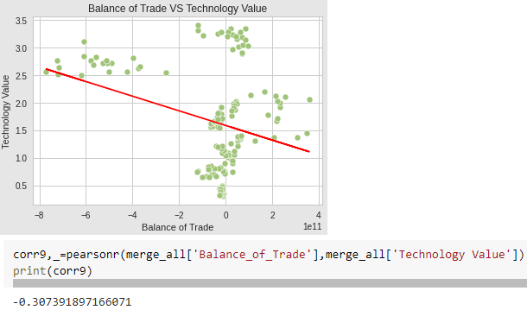
Balance of Trade VS Technology
Correlation between Balance of Trade and Technology.
Technology and import the direction linear regression is ambiguous, it seems almost negative.
Pearson's coefficient show us a negative relationship between Balance of Trade and technology that is not strong enough to be significant.

Slide 35
Correlation among the residuals
One of the assumptions of linear regression is the absence of correlation among the residuals, because they must be independent.
We can check this through the Durbin-Watson test that has the goal to see if there is autocorrelation among residuals. The test can assume values from 0 to 4, where:
Value close to 0, it means that there are more chances of positive serial correlation
Value close to 4, it means that there are more chances of negative serial correlation
Value equal to 2, it means no serial correlation
The rule of thumb, we can conclude that values that are in the range between 1.5 to 2.5 are consider normal values.

Slide 36



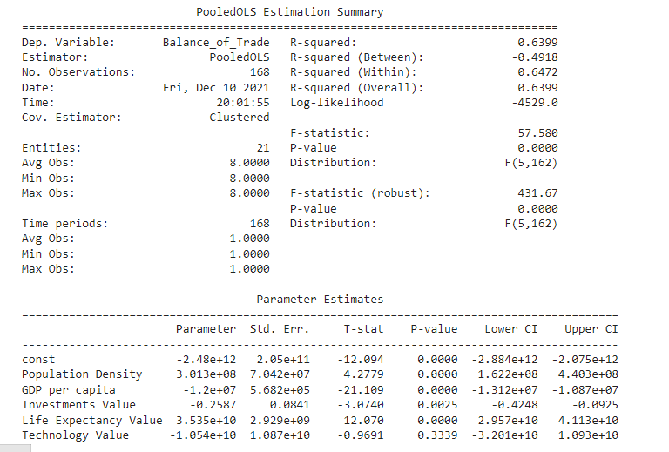

Normal Multiple Regression
T-stat is high, which means there is a high correlation in the residuals among variables.
From the Durbin-Watson Test, the values are normal, and we should not worry too much about autocorrelation.

Slide 37
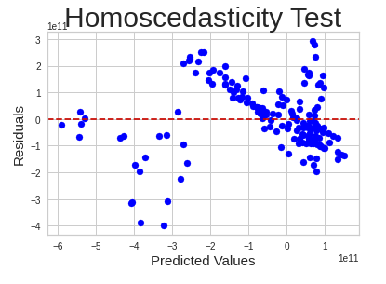
Homoscedasticity
In linear regression is important that the variance of residuals is constant.
There is heteroscedasticity, in fact the points are widely spread.

Slide 38
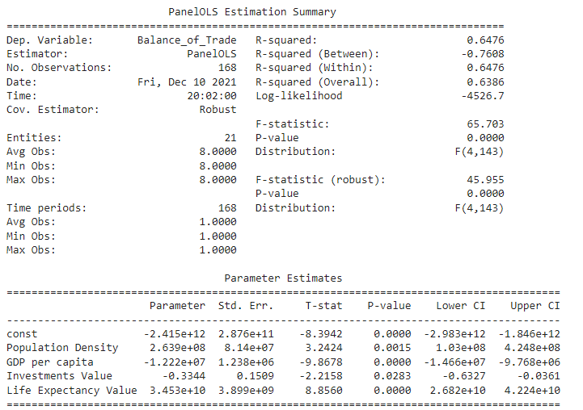
Multiple Regression with White’s Robust Covariance
Compare the results of F-statistic with normal regression and with the White Robust Covariance. The F-statistic in the model with Robustness is lower than without, this means that in this model the independent variables are less important to predict the independent variable and consequently they are also less statistically significant than without robustness.

Slide 39
Testing Hypothesis
Our hypothesis are:
1) Higher is the population density, higher are the Balance of Trade, because of the higher demand.
2) Higher is the GDP, higher is the number of exports and lower is the number of imports. Consequently, the Balance of Trade increase.
3) Higher is the FDI, higher is the number of exports and lower is the number of imports and consequently the Balance of Trade increase.
4)Higher is the life expectancy, higher are the number of exports and imports and, consequently also the Balance the trade increase.
5) Higher is the technology value, higher are the number of exports and lower are the number of imports, because we don't need anymore to import everything. Consequently, the Balance of Trade increase.

Slide 40
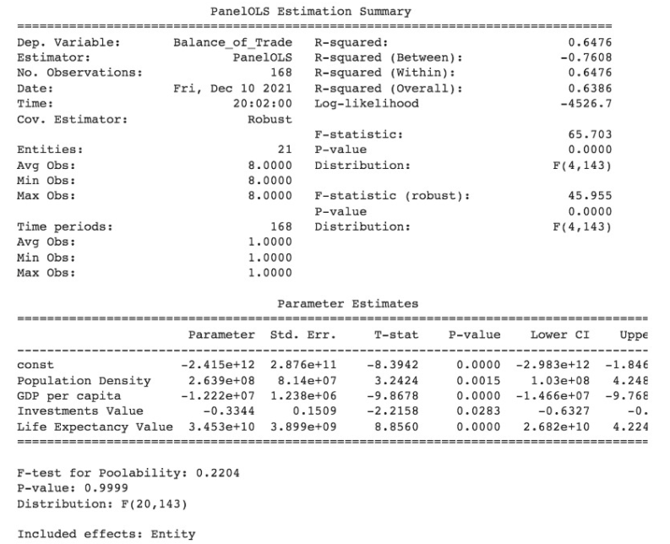
Fixed effect model with the White's Robust covariance

Slide 41
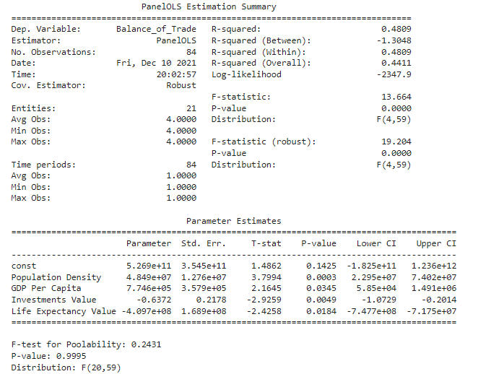
Test Hypothesis (By Continent)
Fixed effect model with the White's Robust covariance

Slide 42
Clustering
It is an unsupervised machine learning algorithm for grouping unlabeled datasets. Its goal is to create clusters or groups from data points in a dataset with high intra-cluster similarity and low inter-cluster similarity.
Using K-means Clustering as a method of data analysis, we classify a given data set using this approach by assigning it to one of a set of "k" clusters. K-Means Clustering is an Unsupervised Learning algorithm used to group the unlabeled dataset into different clusters/subsets

Slide 43
By Country

Slide 44
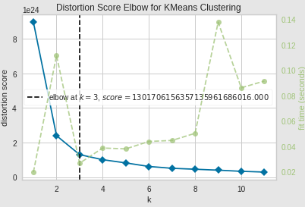
Computing K value
Computing K value using Elbow algorithm
The optimal number of clusters (k) is plotted against the distortion (total of within-cluster sum of squares for a given number of k). The optimal number of k is a point where there is a bend in the curve (elbow). Based on the elbow method, the optimal number of clusters (k) is 3 as the value of k lies between 2 and 4.

Slide 45
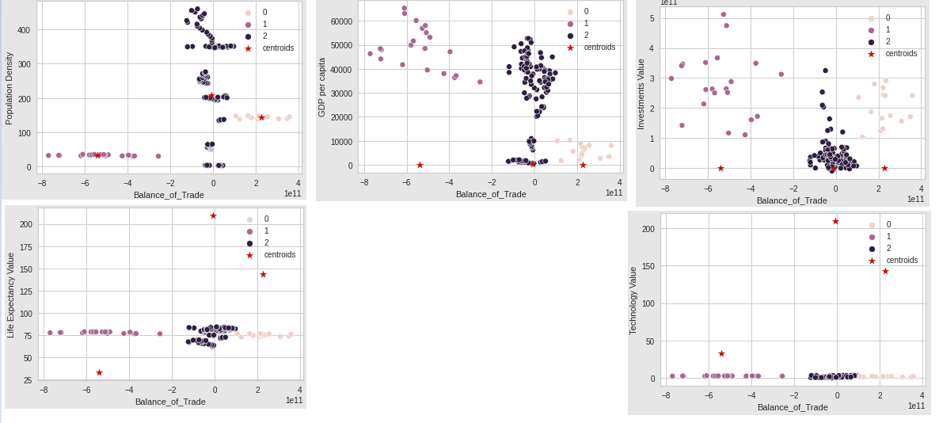
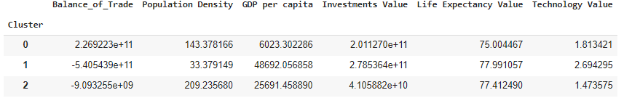
As k-means is a clustering method (not classification), the accuracy should not be evaluated. This is because we do not train the model with class label data and therefore there will be inconsistency in between true class labels and predicted class labels

Slide 46
By Continent

Slide 47
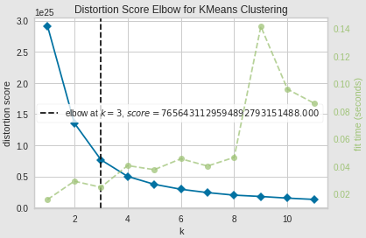
Computing K value
Computing K value using Elbow algorithm
The optimal number of clusters (k) is plotted against the distortion (total of within-cluster sum of squares for a given number of k). The optimal number of k is a point where there is a bend in the curve (elbow). Based on the elbow method, the optimal number of clusters (k) is 3 as the value of k lies between 2 and 4.

Slide 48
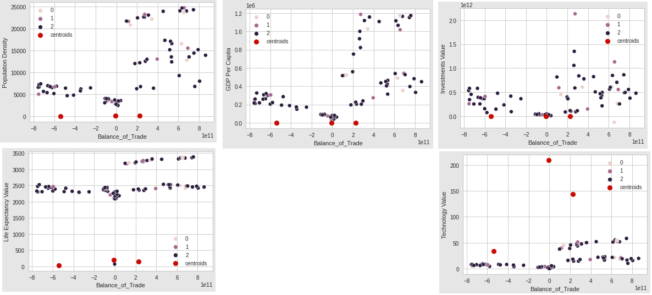
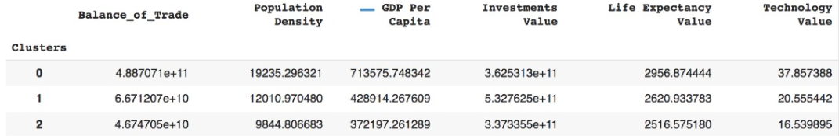
As k-means is a clustering method (not classification), the accuracy should not be evaluated. This is because we do not train the model with class label data and therefore there will be inconsistency in between true class labels and predicted class labels

Slide 49
Conclusion & Improvement
The country dataset and the continent dataset gave us a totally different results in the regression.
Technology is not an important variable to predict the Balance of trade
Investment value is the only result that is reliable for our model.
Our models suffered of a lot of problems as Heteroscedasticity.
Improvement:
Add new variables like education, a political variable, taxes etc.

Slide 50
References
https://apps.bea.gov/iTable/iTable.cfm?ReqID=62&step=1#reqid=62&step=9&isuri=1&6210=4
https://data.worldbank.org/topic/21
https://ourworldindata.org/grapher/population-density?tab=table
https://ourworldindata.org/grapher/real-gdp-per-capita-pwt?time=1960..2017
https://data.worldbank.org/indicator/SP.DYN.LE00.IN?end=2019&start=1960&view=chart
https://data.worldbank.org/topic/science-and-technology
https://data.worldbank.org/indicator/BX.KLT.DINV.CD.WD
https://pandas.pydata.org/docs https://datatofish.com/plot-dataframe-pandas/
https://realpython.com/
https://swcarpentry.github.io/python-novice-gapminder/09-plotting/index.html
https://stackoverflow.com/questions/55895097/how-to-calculate-covariance-matrix-of-data-frame/55914209
https://machinelearningmastery.com/how-to-use-correlation-to-understand-the-relationship-between-variables/

